Slide 1
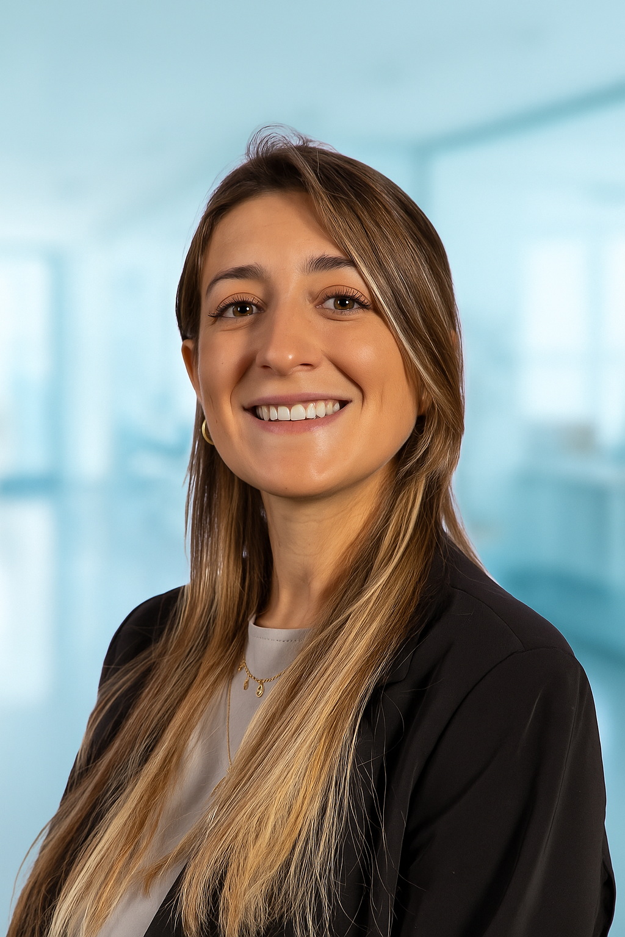
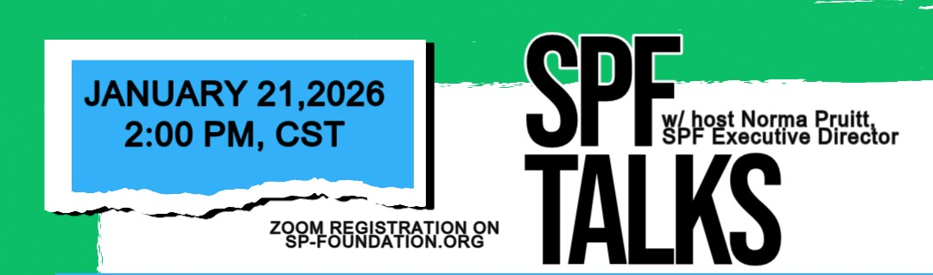
PLS | International collaborations over the last years
Erica Scirocco, MD | Post Doctoral Research Fellow
Sean M. Healey & AMG Center for ALS
Neurological Clinical Research Institute
Massachusetts General Hospital (MGH)
Harvard Medical School (HMS)

Slide 2
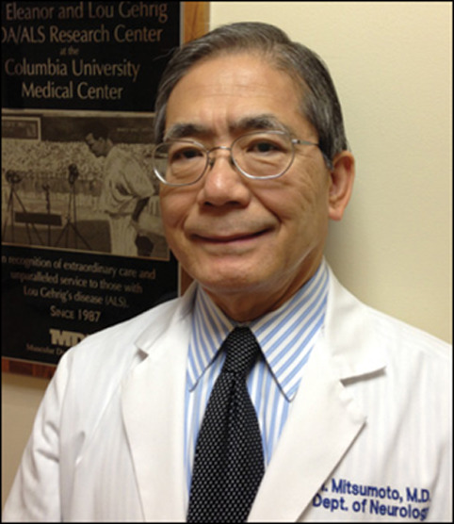




Thank you
The Campbell Family in loving memory of Thurza
Mr. David Marren
and Family

Slide 3
In the last 2 years…

Slide 4
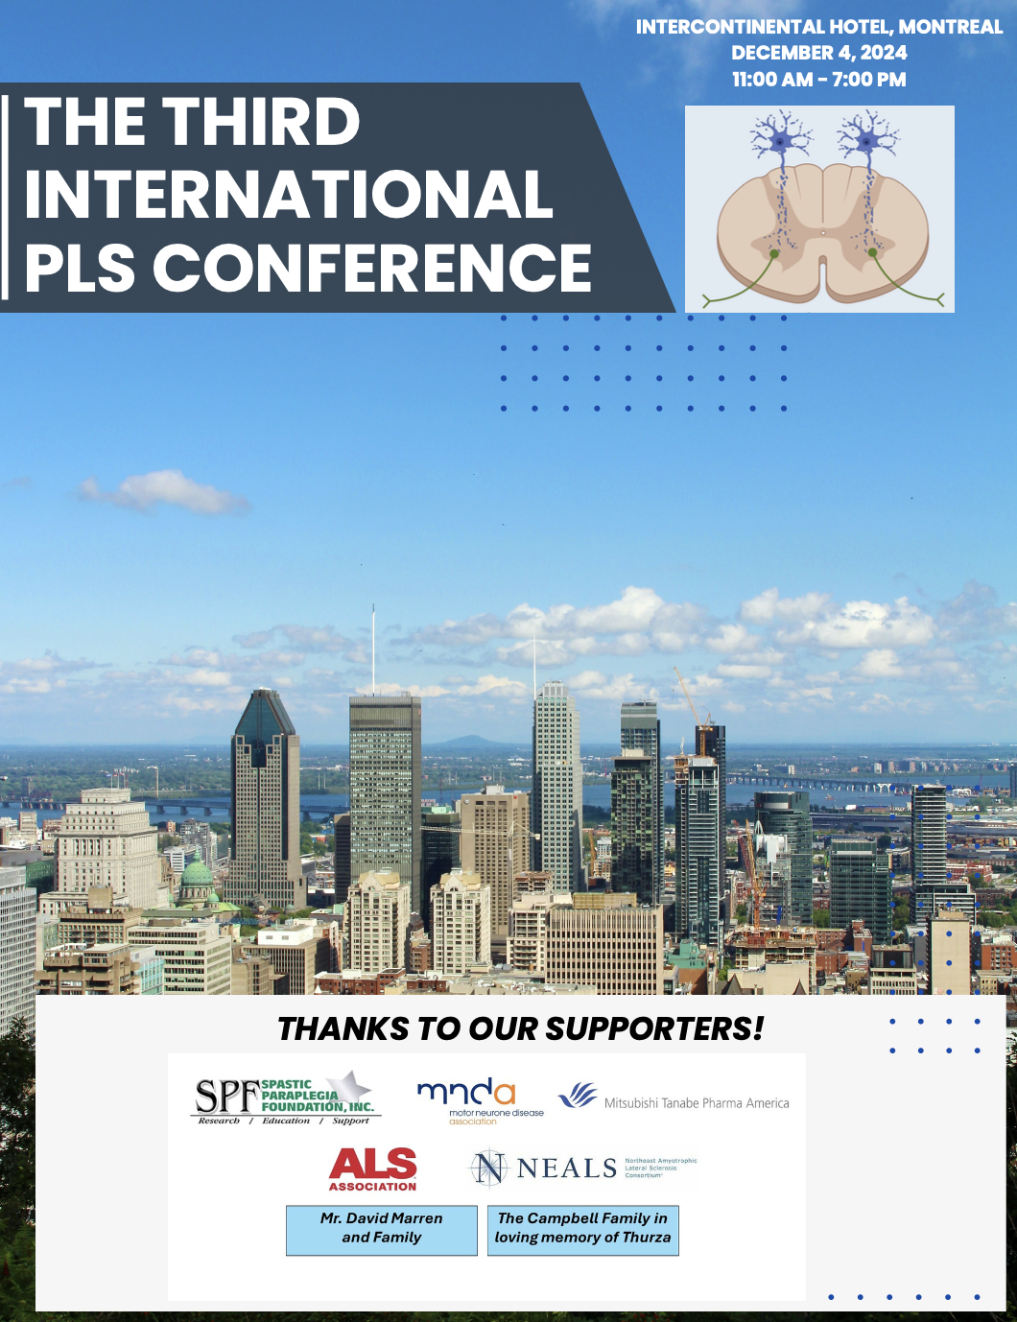
2024
December, Montreal
The 3rd International PLS Conference in 2024 (previous in 2004 and 2019) brought together more than 100 participants from around the world, including leading clinicians, researchers, ambassadors, as well as individuals living with PLS, caregivers, and families impacted by PLS

Slide 5

This conference opened the door
to many other opportunities

Slide 6

Prepare your phone to scan QR codes

Slide 7
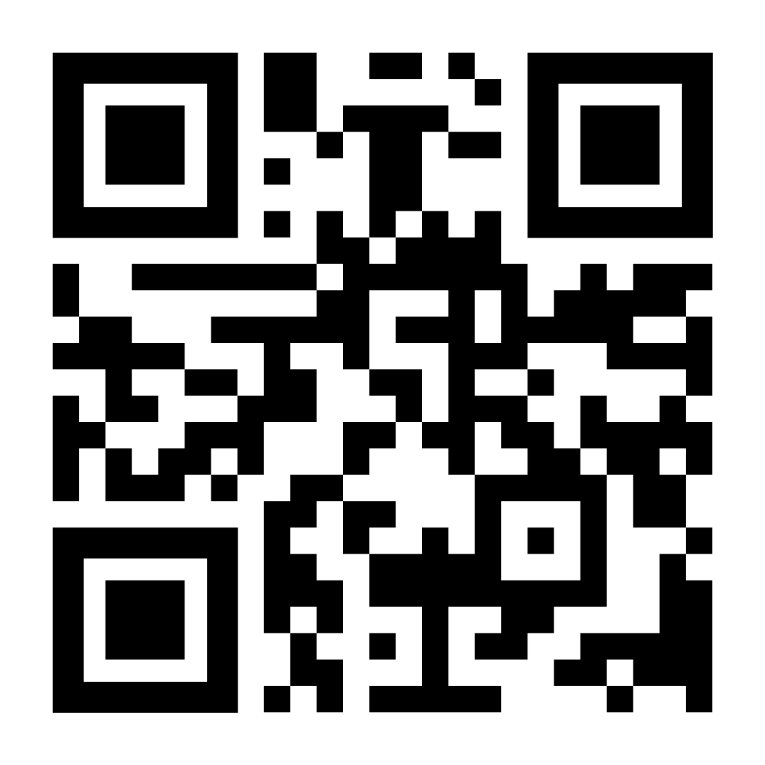


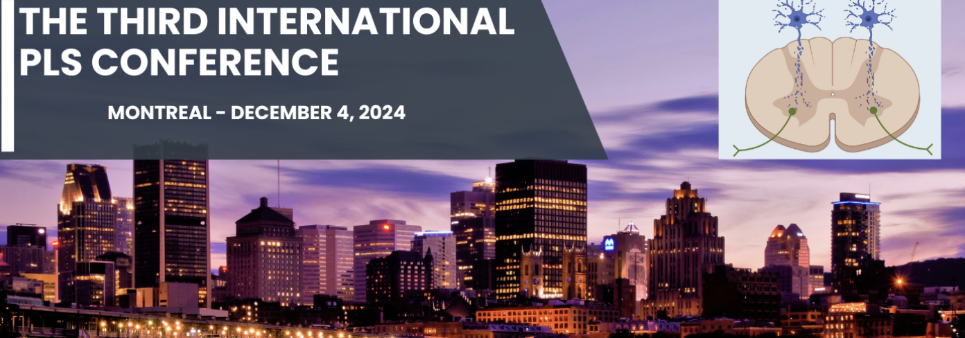
2025
January
Panel Discussion Video | PLS Conference

Slide 8
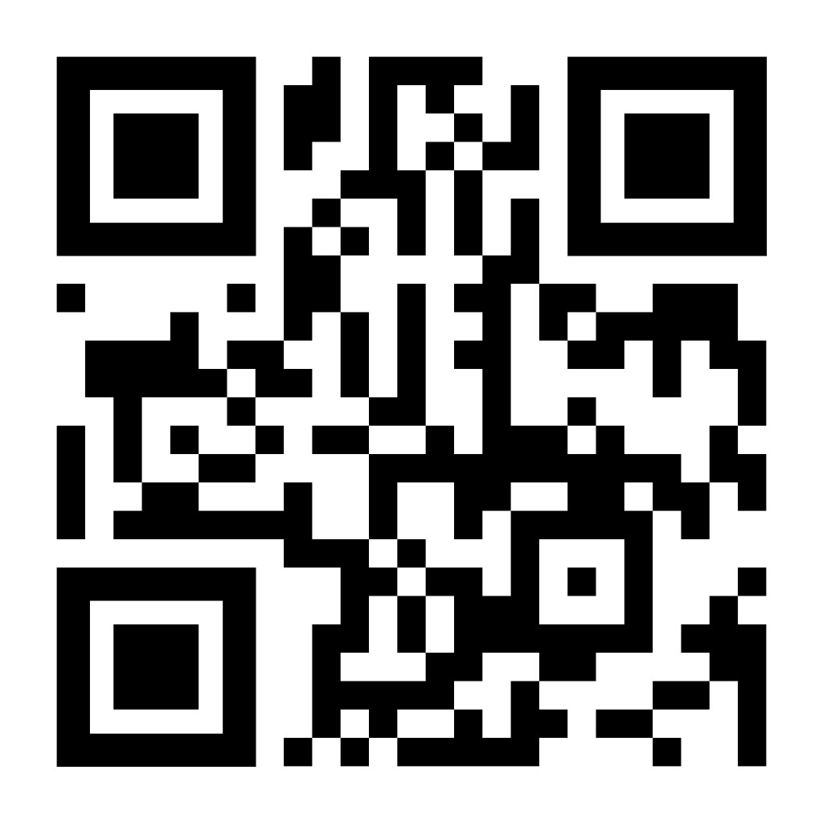
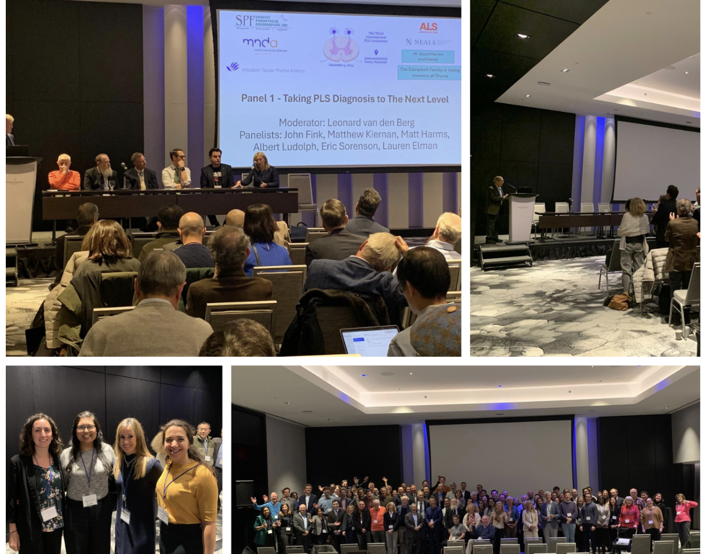

2025
February
MND Blog Post | PLS Conference

Slide 9

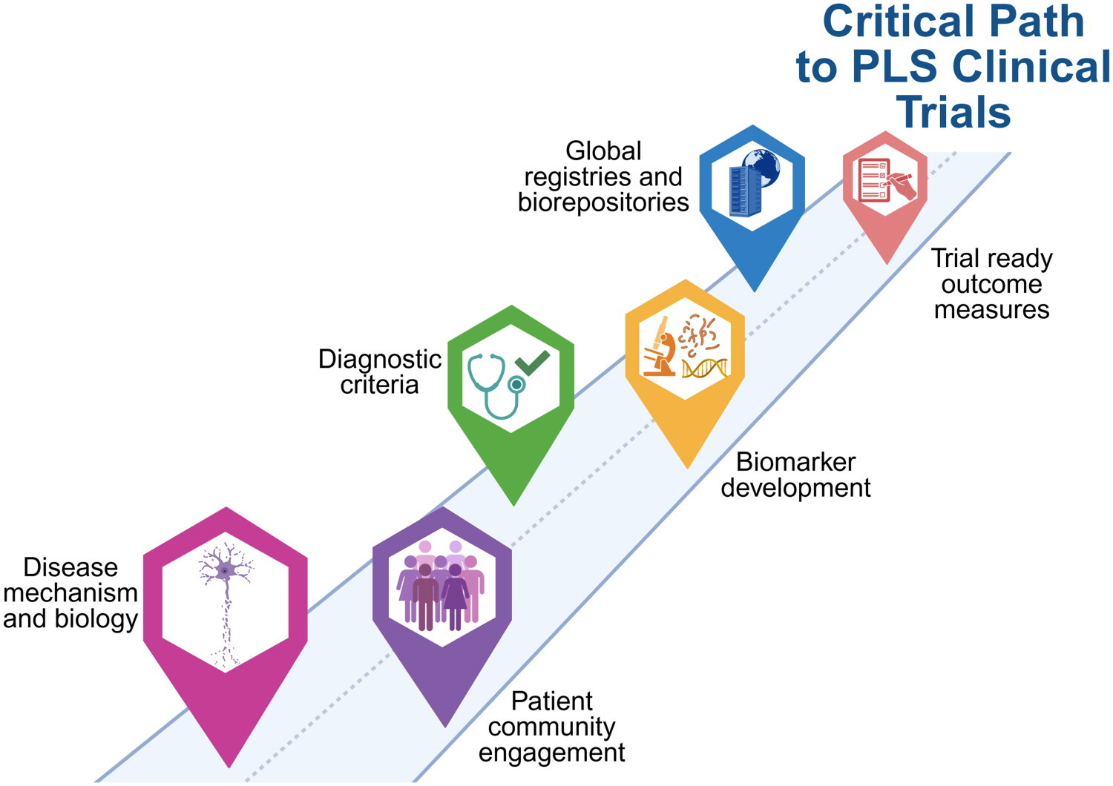
2025
June
Academical paper on PLS co-authored by the researchers that met in Montreal

Slide 10
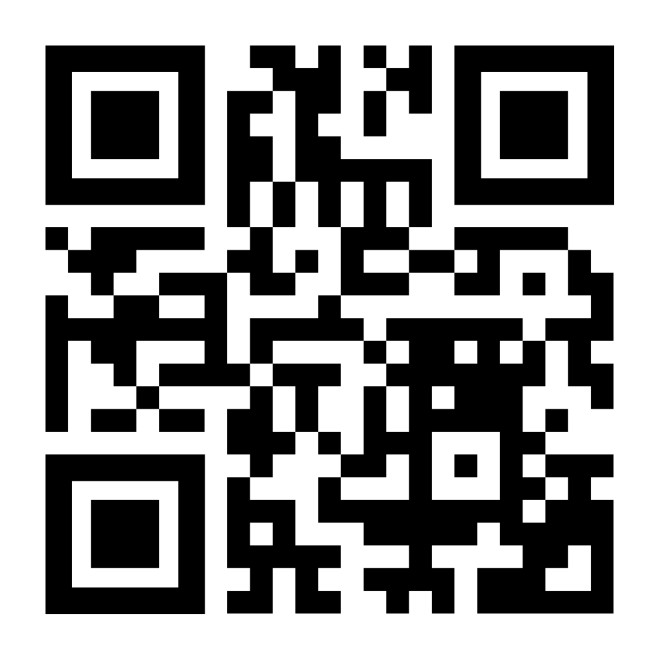
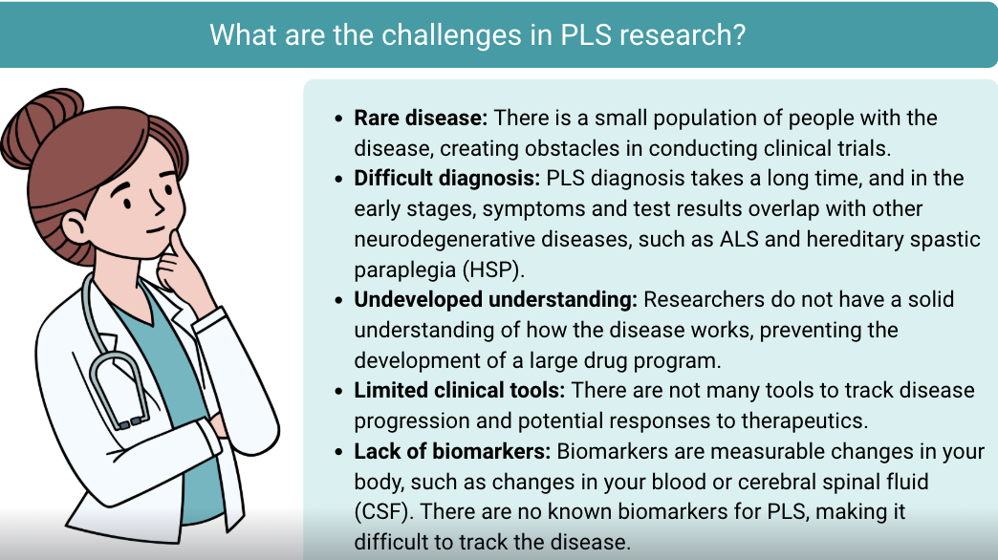
2025
PLS Research Summary

Slide 11
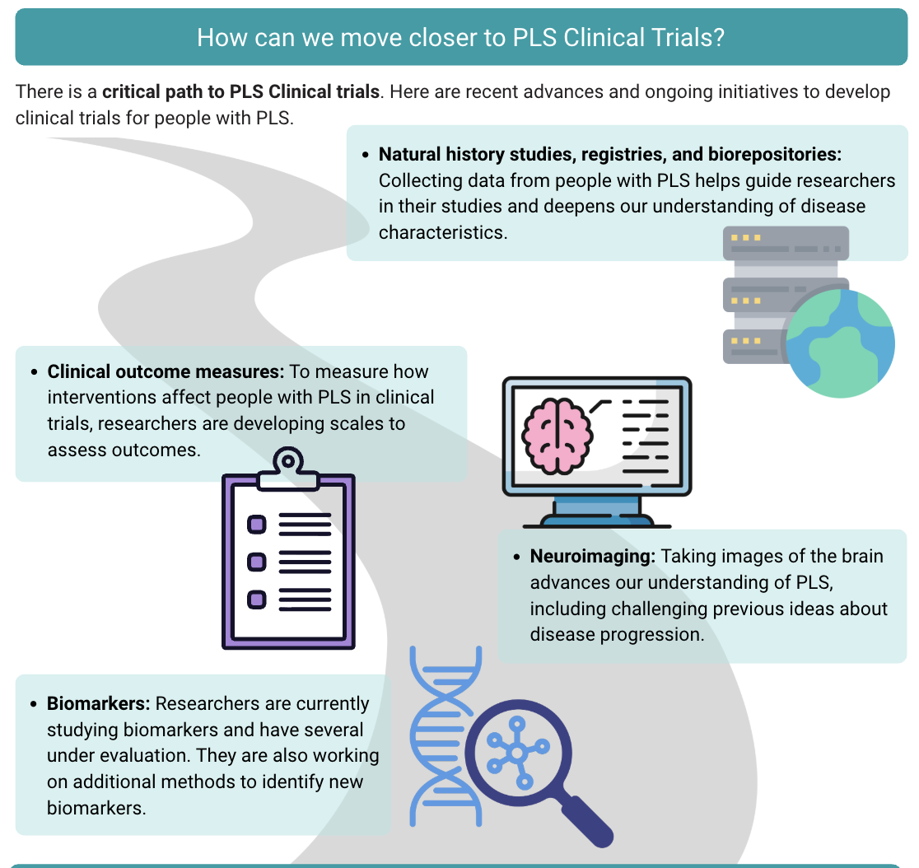
2025
PLS Research Summary

Slide 12
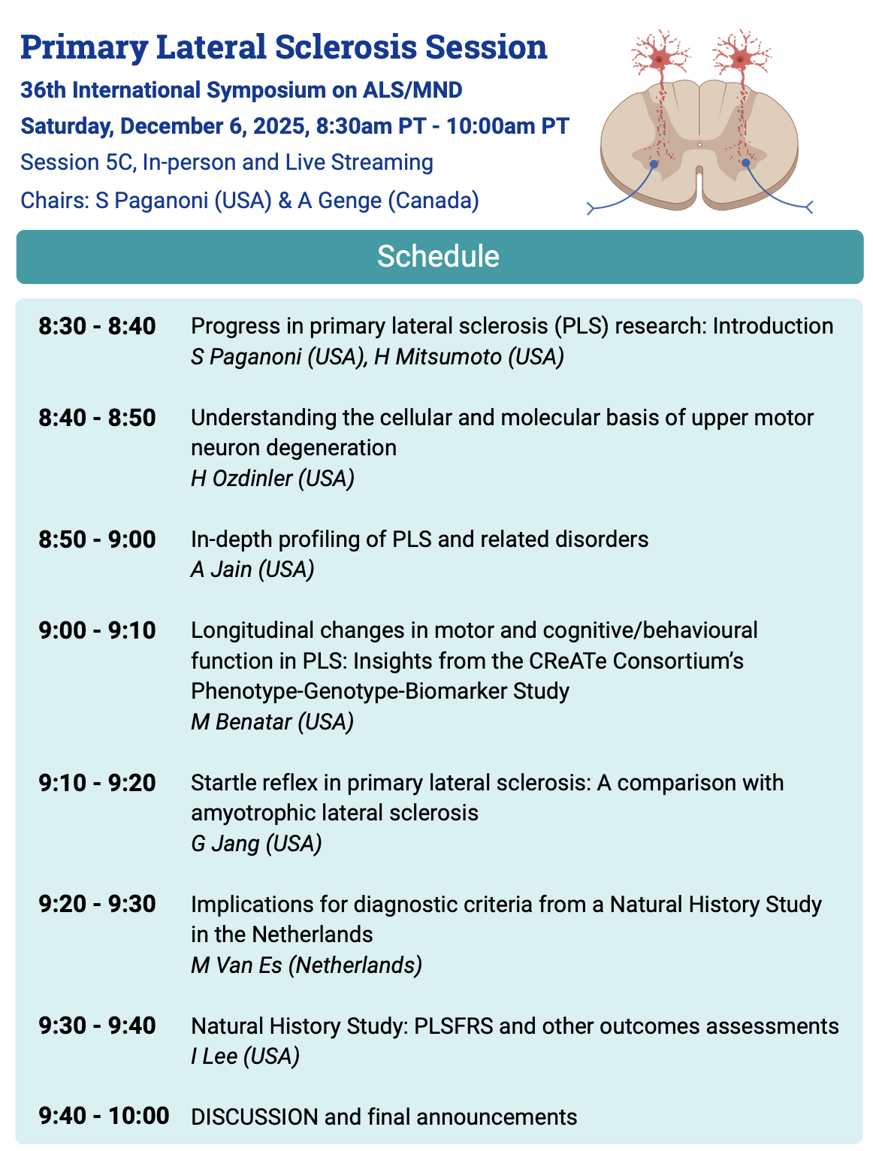
2025
December, San Diego
Several scientists gathered to share updates on PLS research!
The first PLS-dedicated session included in the main program of the 36th International Symposium on ALS/MND, reflecting growing recognition of PLS within the ALS/MND research field

Slide 13
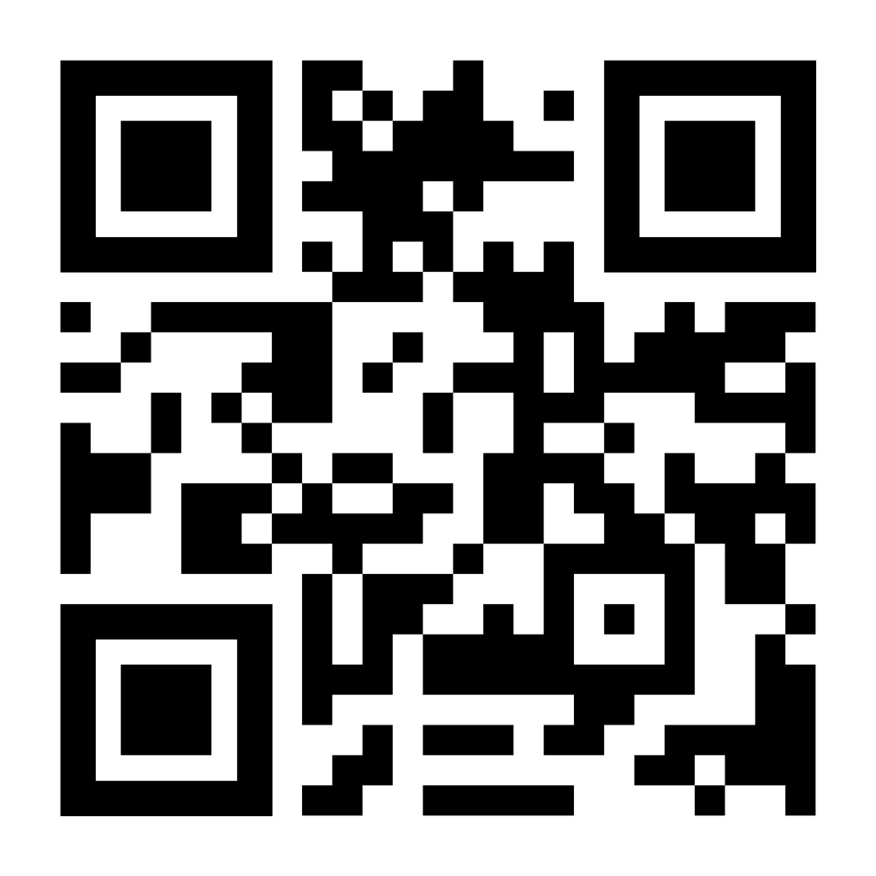

2025
December, San Diego
The PLS session concluded with the presentation of two PLS abstract awards (2026) honoring the legacy of Thurza Campbell and the Marren Family
PLS Session Highlights | LinkedIn Post

Slide 14
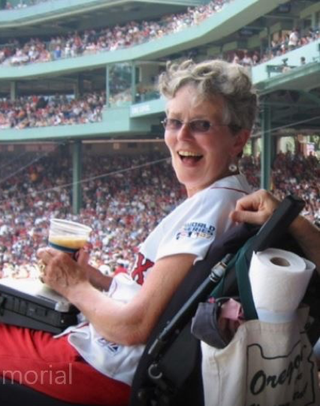
2026
The Thurza Campbell Award for
Basic Science Innovation in PLS

Slide 15

2026
The Marren Family Award for
Clinical Innovation in PLS

Slide 16

2026
Huge interest from MNDA to make the PLS session an annual event of the International Symposium of ALS/MND!
Planning is already underway with MNDA and international collaborators for next year’s PLS session!
The recording of the 2025 PLS session will be available for everyone on March 4, 2026, via the International Symposium of ALS/MND website
In the meantime, keep an eye out for a blog post about PLS on the MNDA website summarizing key takeaways of the 2025 session - scheduled for publication tomorrow, Thursday, January 21, 2026

