Slide 1

Spasticity Management
Bianca Martinez, MD
Sea Girt Physical Medicine & Rehabilitation Associates

Slide 2
outline
What is spasticity?
Complications due to spasticity
Common presentation in the upper limb
Common presentation in the lower limb
Treatment goals
Current treatment options
Overview of lower limb orthoses for ambulation
Future directions
Patient Story & Treatment Plan

Slide 3
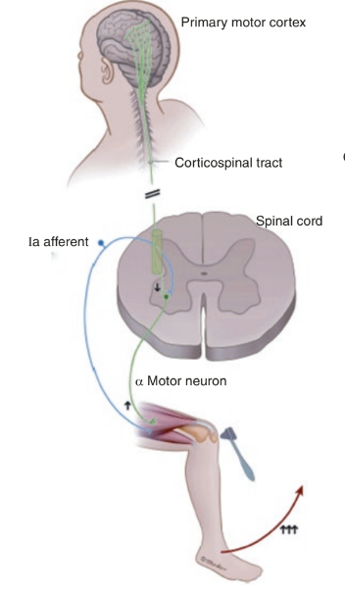
What is Spasticity?
There are 2 way tracks that go from our brain to our muscle to control movement
Track 1:
Primary motor cortex (brain) → corticospinal tract (spinal cord) → peripheral nerve → muscle → contraction
Track 2:
Sensory nerve (IA afferent) → spinal cord (interneurons) → muscle → relaxation
In general, in ALS and PLS both upper and lower limbs are affected while in HSP only lower limbs are affected
Notes:
Let’s consider a car. You press your break so you don’t go so fast and your gas so you can go.
When you have an upper motor neuron injury (injury to brain and spinal cord), spasticity results when the break malfunctions and the muscles are just firing constantly, resulting in stiff muscles.

Slide 4
Spasticity Sequela
Persistent and untreated spasticity
Pain
Contractures
Limb and trunk deformity
Impaired movement and ambulation, seating
Skin breakdown
Difficulty with self-care and hygiene
Poor body image and self esteem

Slide 5
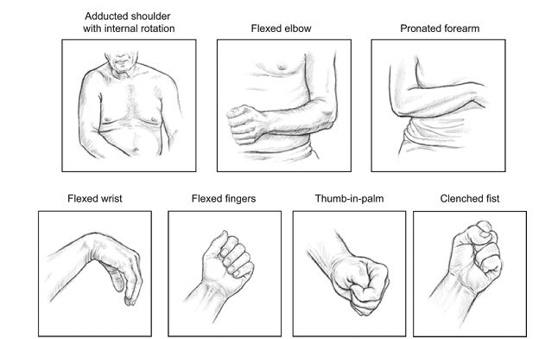
Upper limb spasticity
Source: Simpson, D, et al. OnabotulinumtoxinA Injection for Poststroke Upper-Limb Spasticity: Guidance for Early Injectors From a Delphi Panel Process

Slide 6
Upper limb spasticity
Increased tightness in muscles
  Chest wall → difficulty raising the arm, putting on clothing, cleaning axilla
  Elbow flexors → difficulty straightening the arm to reach for items or dressing
  Wrist flexors and finger flexors → difficult opening hand voluntarily or passively (releasing items, hand hygiene)

Slide 7
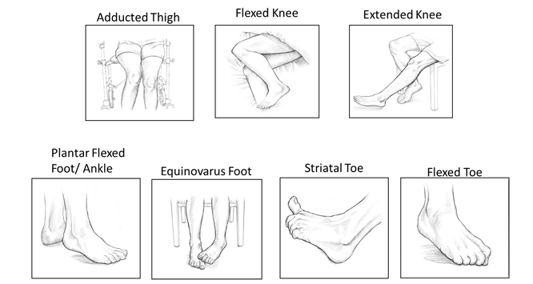
lower limb spasticity
Source: Esquenazi, A. et al. OnabotulinumtoxinA for Lower Limb Spasticity: Guidance from a Delphi Panel Approach

Slide 8
Lower limb spasticity
Increased tightness in muscles
  Hamstrings → difficulty straightening the leg
  Quadriceps → stiff knee gait
  Calf muscles -→ difficulty clearing toes when walking (tripping), foot turns in when walking, knee can snap back/hyperextend
  Inner thighs → legs cross over each other when walking (scissoring gait), difficult pulling legs apart for hygiene and dressing
  Toe muscles → toe curling, upgoing big toe/striatal toe, toe clawing

Slide 9
Treatment goals
Improve positioning
Decrease pain
Improve ease of providing hygiene
Improve function
Improve cosmesis

Slide 10
CURRENT Treatment Options
Nonpharmacologic
Stretching
Splinting – dynamic and static
Serial casting
Surgical procedures
  Dorsal rhizotomy
  Tendon transfers/lengthening
  Nerve transfer
  Functional neurotomy
Pharmacologic
Oral medications
  Baclofen, tizanidine, clonidine, dantrolene, benzodiazepines
Transdermal
  clonidine
Intrathecal
  baclofen
Focal/injectable
  Botulinum toxins (chemodenervation)
  Phenol (chemoneurolysis)

Slide 11
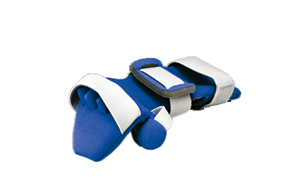
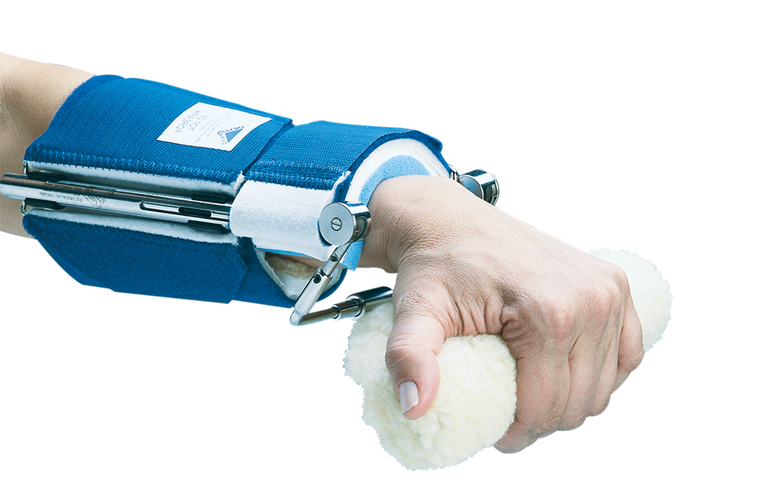
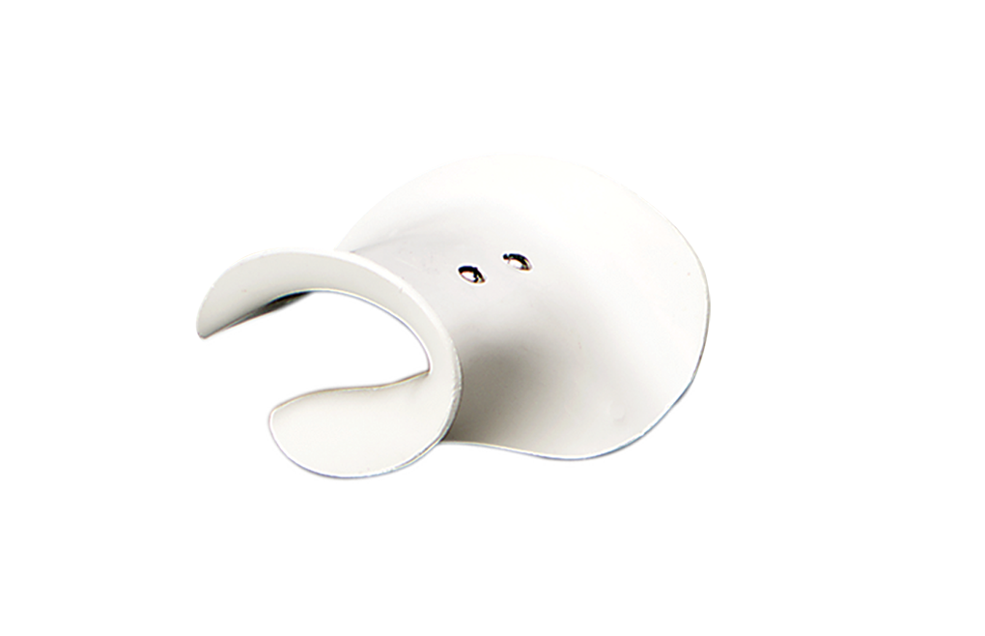
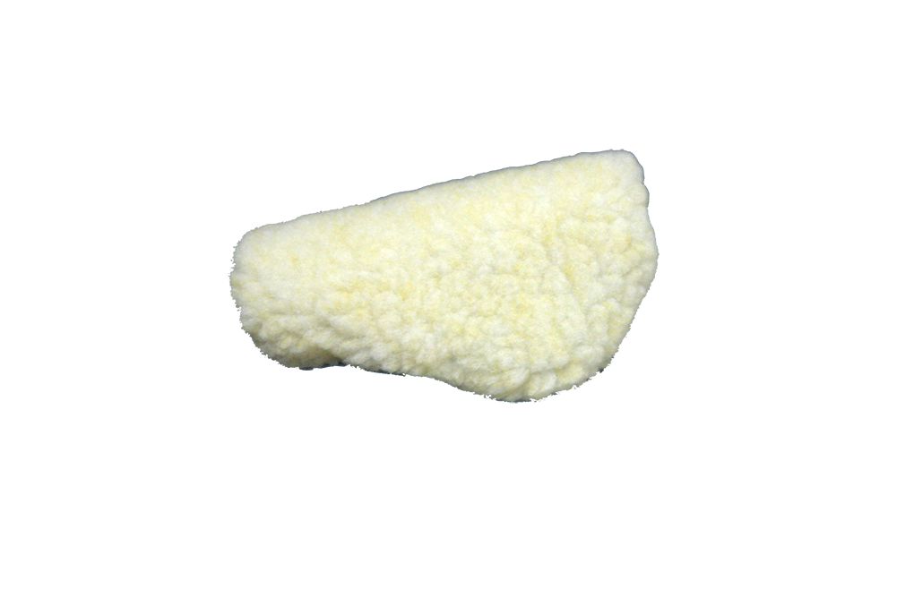
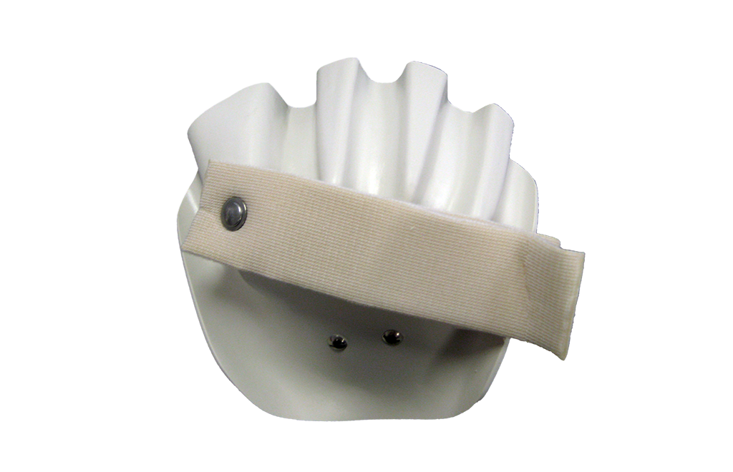
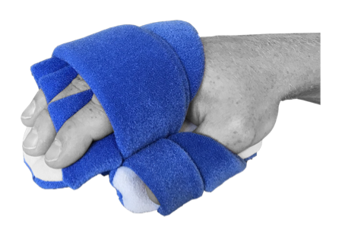
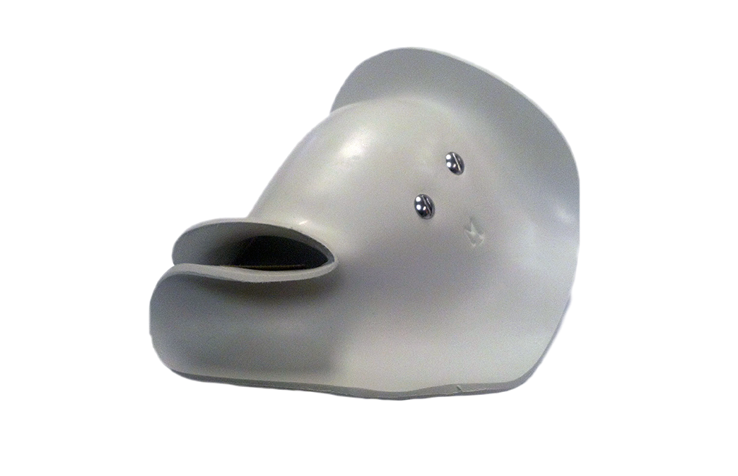
Splinting – wrist/hand
Neurological Wrist Extension Dynasplint
Range of motion: 45 degrees flexion to 45 degrees extension
Hand pan “C” cup hand
Resting hand wrist orthosis
Padded palmar bar
Anti-spasticity ball hand
Mitt splint hand
Progressive hand attachment
Notes:
Sidelying shoulder pillows
Pillow splints
Static elbow extension splint (dynasplint)

Slide 12
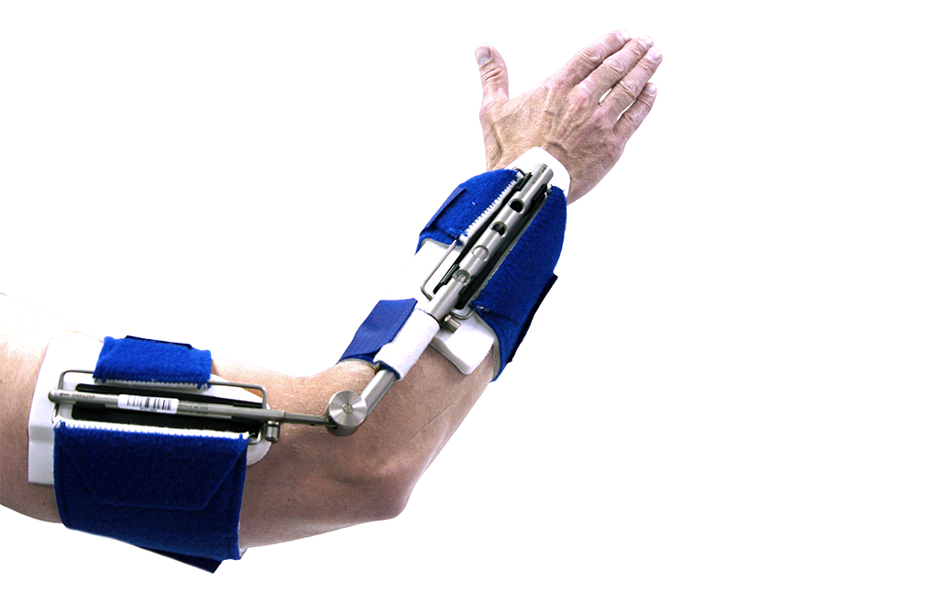
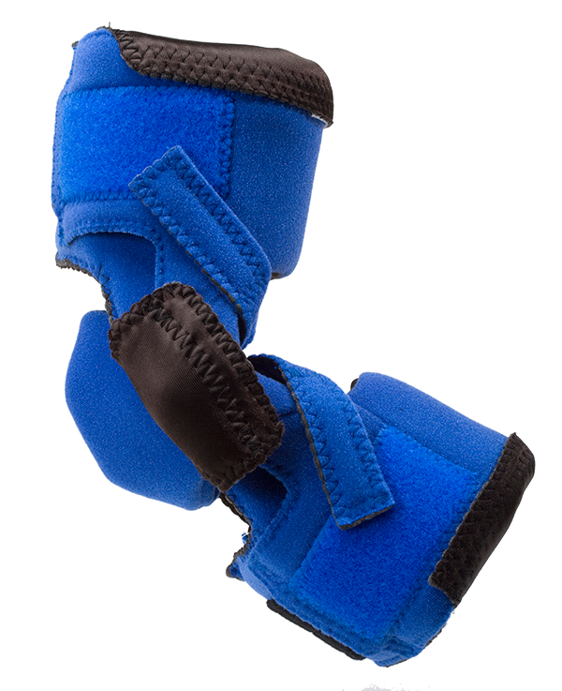
Splinting - elbow
Elbow Flexion Dynasplint System
Range of Motion: 50 degrees flexion to 140 degrees flexion
NeuroFlex
Restorative Elbow

Slide 13
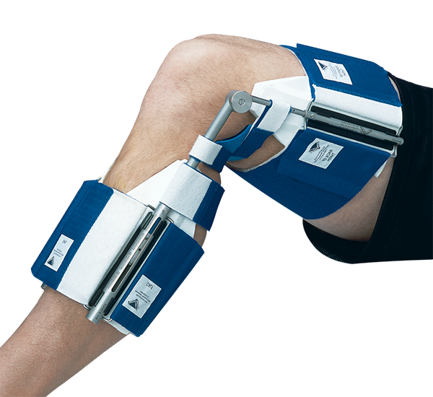
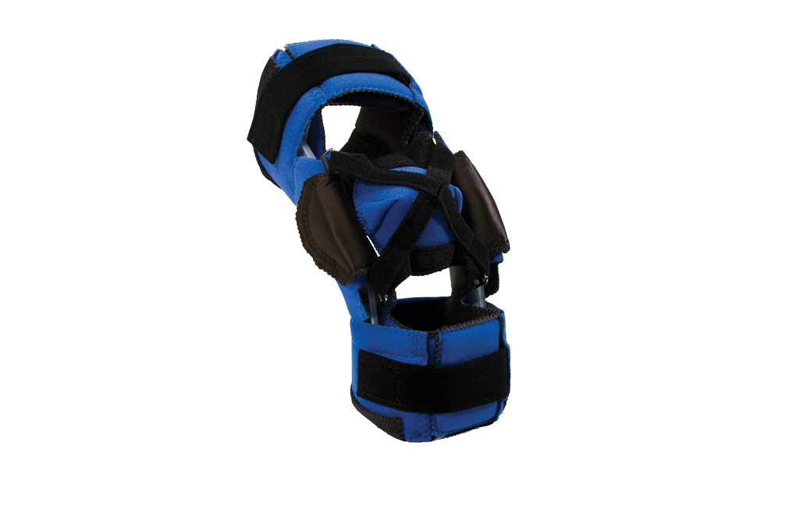
Splinting - KNEE
Knee Flexion Dynasplint
Range of Motion: 50 degrees flexion to 140 flexion
NeuroFlex Restorative Knee
Notes:
Sidelying shoulder pillows
Pillow splints
Static elbow extension splint (dynasplint)

Slide 14
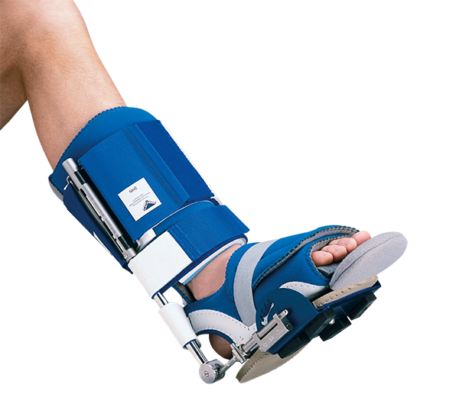
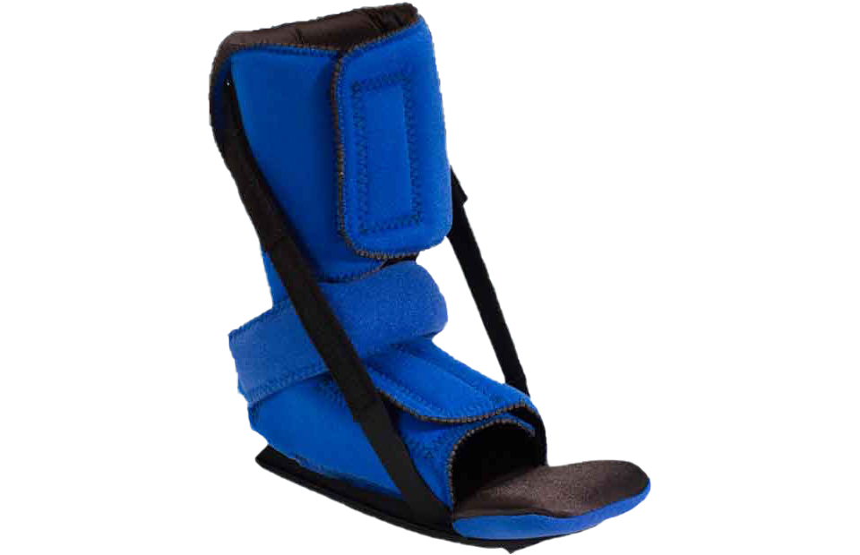
Splint - Ankle
Ankle Dorsiflexion Dynasplint with ankle foot orthosis
Range of Motion: 50 degrees plantarflexion to 40 degrees dorsiflexion
RM Safe Boot II

Slide 15
Oral medications
Tizanidine (Zanaflex)
  Adverse effects: drowsiness, dizziness, dry mouth, orthostatic hypotension
Baclofen
  Adverse effects: weakness, sedation, hypotonia, lowers seizure threshold
  Sudden withdrawal may cause seizures, hallucinations, rebound spasticity
Dantrolene
  Adverse effects: weakness, drowsiness, nausea, diarrhea, liver toxicity

Slide 16
Chemodenervation with Botulinum Toxin
Injected directly into overactive muscles; disrupts release of Ach at NMJ
Reduces contractions, relaxes muscles
Advantages:
  Avoids systemic effects
  Focal treatment
Onset: 3-4 days, peak effect: 2-3 weeks, duration: 3 months
Formulations:
  Botox
  Dysport
  Xeomin
  Myobloc

Slide 17
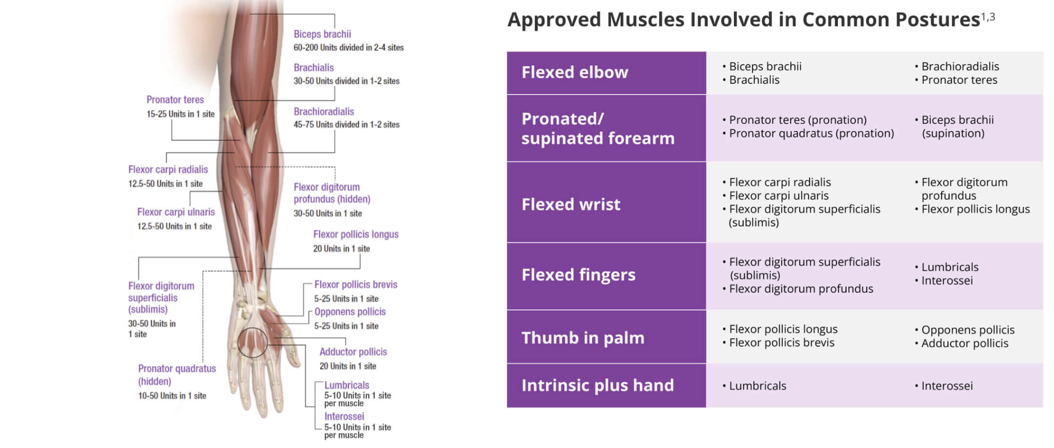
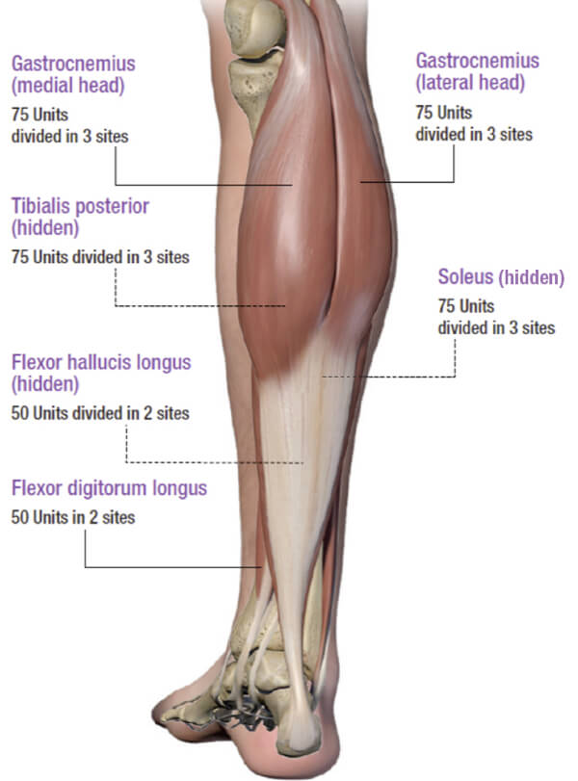
Chemodenervation with Botulinum Toxin

Slide 18
Chemoneurolysis
Phenol is used to destroy peripheral nerves in the upper and lower limbs that are innervating the overactive muscles to produce relaxation.
Phenol works immediately after injection and lasts 6 months and longer in many cases
DO NOT use in neck, chest wall, hands, or feet
It is helpful when there is not enough botulinum toxin to adequately control spasticity or when longer lasting results are desired

Slide 19
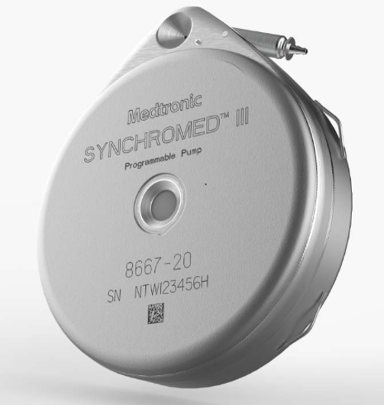
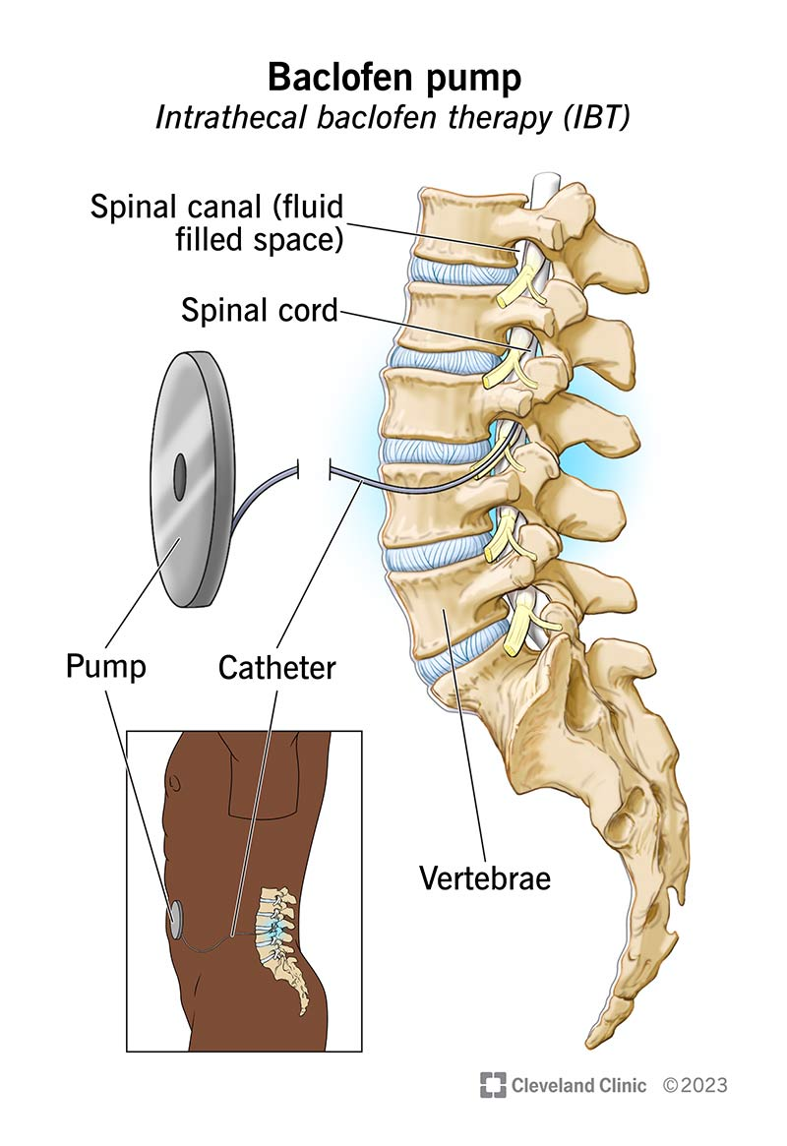
Baclofen pumps
A good option for patients with lower limb spasticity
The dose of intrathecal baclofen is significantly lower than the oral dose of baclofen
A trial can be done in which a 50 ug bolus of baclofen is injected into the intrathecal space of the spine. Spasticity is assessed before and 2 and 4 hours after the trial.
If the trial is successful, a baclofen pump can be implanted by a neurosurgeon
Baclofen pump dose and refills are done during outpatient visits
Baclofen pumps are replaced every 6-7 years

Slide 20
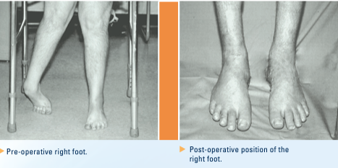
Surgery – Tendon transfer, tenotomy, lengthening
Achilles tendon lengthening & SPLATT for equinovarus contracture.
Source:Penn Neuro-Orthopaedics Service Pamphlet

Slide 21
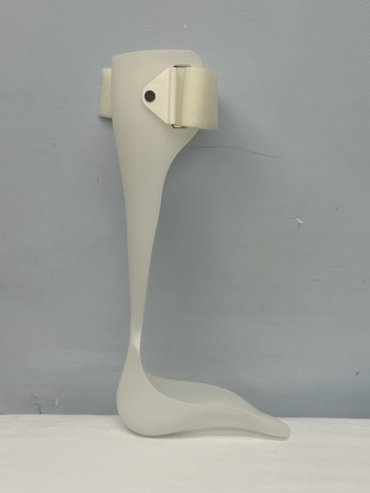
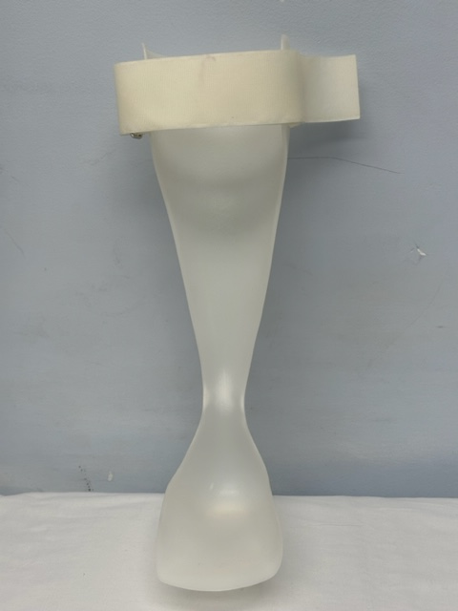
Lower extremity orthoses
Solid Ankle Molded Ankle Foot Orthosis

Slide 22
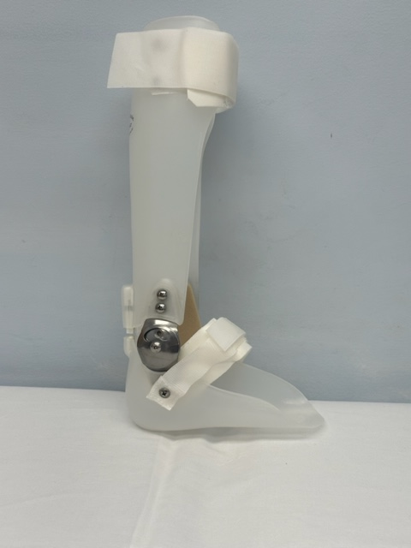
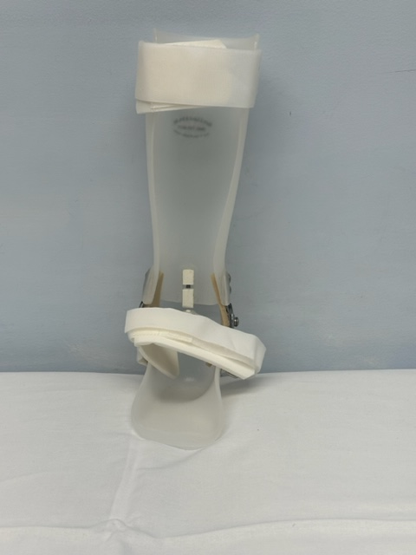
Lower extremity orthoses
Articulating molded ankle foot orthosis

Slide 23
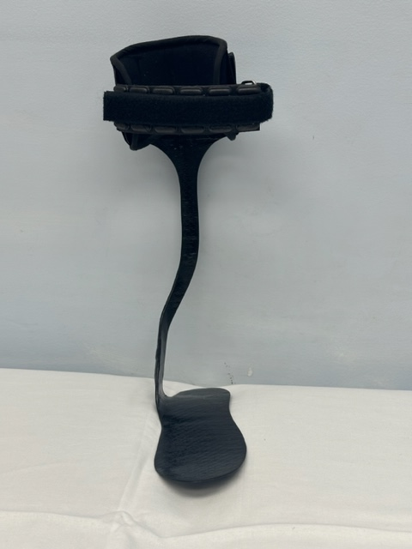
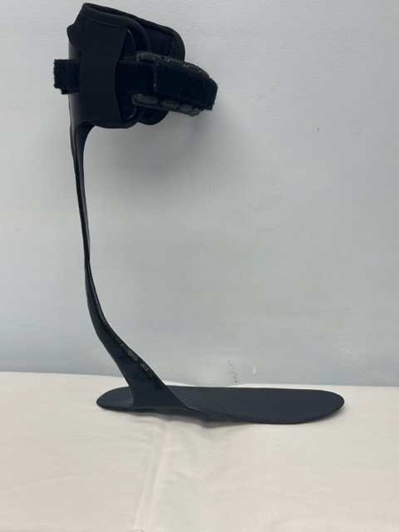
Lower extremity orthoses
Carbon fiber posterior strut

Slide 24
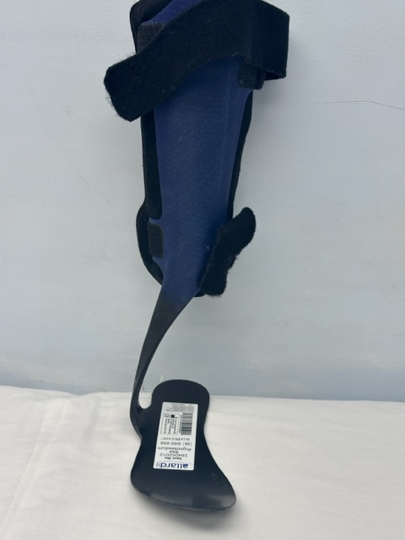
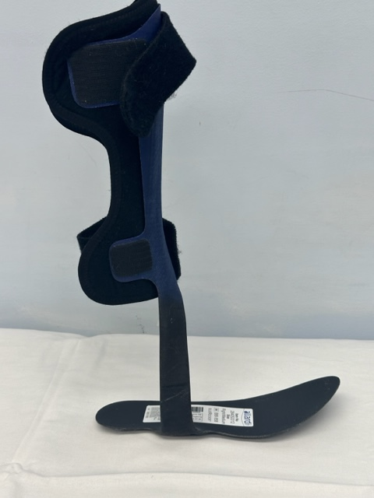
Lower extremity orthoses
Carbon fiber anterior strut

Slide 25
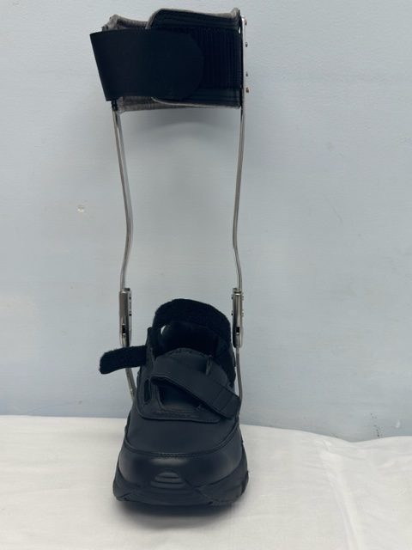
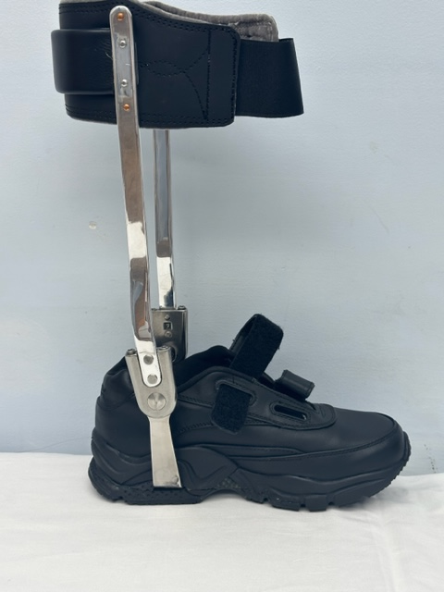
Lower extremity orthoses
Double upright AFO

Slide 26
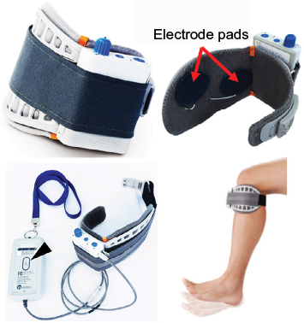
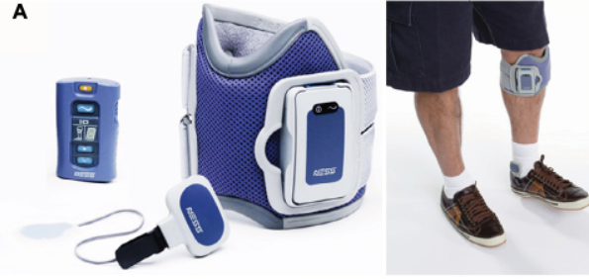
Advanced Functional electrical stimulation devices
Functional electrical stimulation produces a stimulation that compensates for voluntary motion. In the lower limbs, devices have focused on producing ankle dorsiflexion
The drop foot during swing phase of gait is one of the risk factors for a fall. In these devices, surface electrodes for stimulation are fixed by a cuff to the leg below the knee. Electrical stimulation is delivered during the swing phase of gait, producing ankle dorsiflexion and clearance of the foot.
Foot Drop Stimulation Versus Ankle Foot Orthosis After Stroke (FASTEST) Trial was a multicenter, randomized, single-blinded trial comparing FES device and AFO for drop foot among people after stroke. Using either an FES or an AFO for 30 weeks yielded statistically significant improvement sin gait speed and other functional outcomes. No difference was found between the two groups.
Similar results found in the RALLY trial which evaluated whether the Walkaide device could improve walking ability
WalkAide system (Innovative Neurotronics)
NESS L300 (Bioness)
Notes:
Exclusion: fixed contractures of ankle joint in plantarflexion, poor condition of skin at site of FES, chronic edema at site of FES, diagnosis of DVT, peripheral nerve damage (according to EMG), metal implants in region of FES

Slide 27
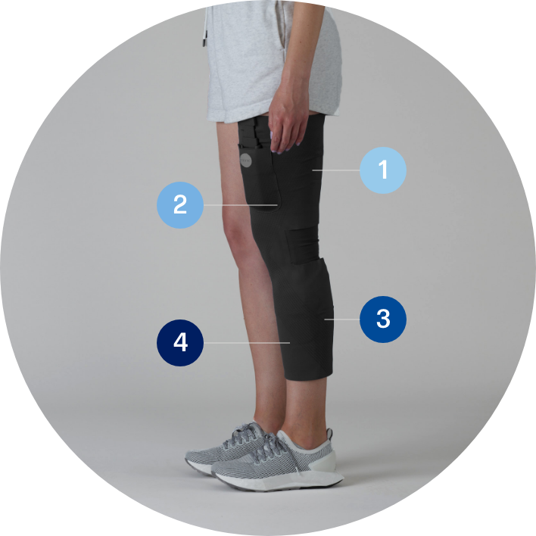
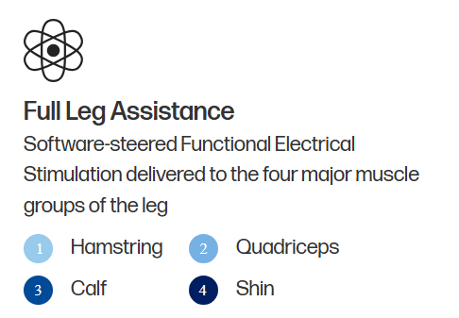
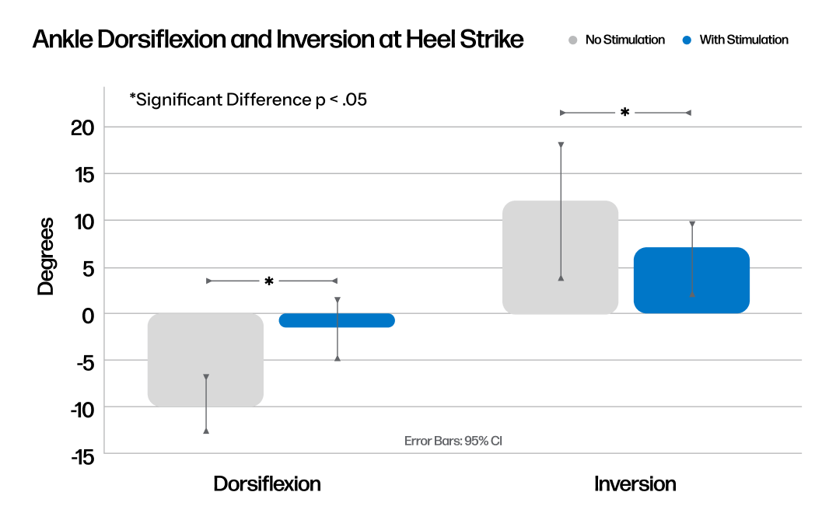
Advanced Functional electrical stimulation devices
Cionic Neural Sleeve
First algorithm-powered bionic clothing designed to restore mobility in people with neurological conditions.
Pilot study, “Impact of the Cionic Neural Sleeve on Ankle Kinematics during Gait in Multiple Sclerosis” evaluated 2 key measured related to difficulties with walking
  decreased dorsiflexion or difficulty lifting the foot
  Increased inversion or the tendency for the ankle to roll inward
Results demonstrated significant improvements for both measures

Slide 28
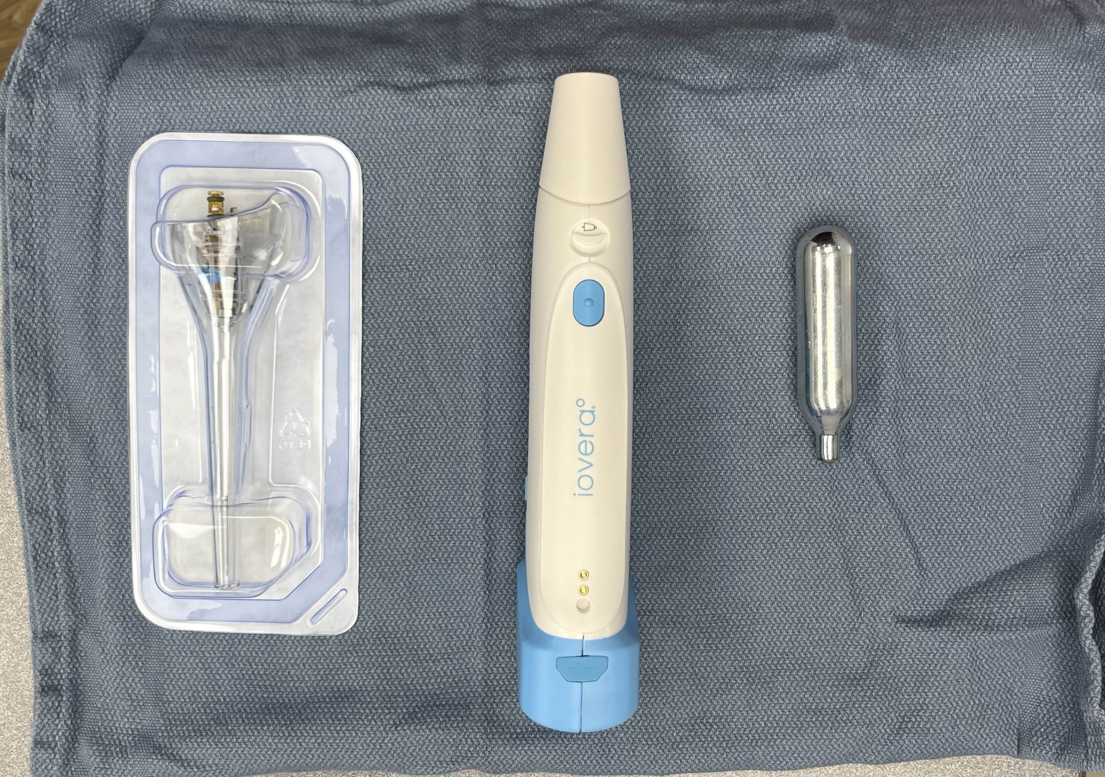
Future considerations
Cryodenervation – the use of an ice ball to cause nerve degeneration and thereby relax the spastic muscle
Hyaluronidase – an enzyme that breaks down hyaluronic acid which accumulates in paretic muscles and causes muscle stiffness
Shorter duration toxins
  trenibotulinumtoxine
Longer duration toxins
  daxibotulinumtoxinA

Slide 29
Patient story– “ComBo Platter Please”
55 year old male with hereditary spastic paraparesis presents with spasticity. He states that it is difficult to spread his legs apart when he walks and he tends to scissor. He drags his foot and has difficulty fully extending his leg so he walks with a crouched gait and takes short strides. On exam there was spasticity in the bilateral inner thigh muscles (adductor longus, adductor magnus, and adductor brevis), the hamstrings (semitendinosus, semimembranosus, and biceps femoris) and the calf muscles (gastrocnemius/soleus).
Goals: improve gait to go on longer walks in the neighborhood and travel, improve sleep by addressing nocturnal spasms
Treatment plan:
Phenol blocks to the bilateral obturator nerves
Chemodenervation to the calf muscles (gastrocnemius and soleus - 1000 units of Dysport)
Cryodenervation to the nerves innervating the hamstrings (biceps femoris, semimembranosus, and semitendinosus)
Tizanidine 2 mg at bedtime for nocturnal spasms
Bilateral custom molded articulating ankle foot orthoses with a posterior stop

Slide 30
Questions
Thank you!

